Slide 1
LANDSLIDE MONITORING SYSTEM Category:- SMART CITY

Slide 2
PROBLEM
Unexpected landslides cause traffic jams
Traffic jams cause delay in arrival of clearance vehicles

Slide 3
IDEATION
Immediately detecting the landslides in the landslide prone areas
Sending alerts to traffic police and PWD
Instantaneous arrival of clearance vehicles

Slide 4
SOLUTION
Using soil moisture sensing module to sense the loosening of soil
Using accelerometer to sense the motion of rocks
Using ultrasonic sensors to detect the landslide
Using GSM module to send SMS alerts

Slide 5
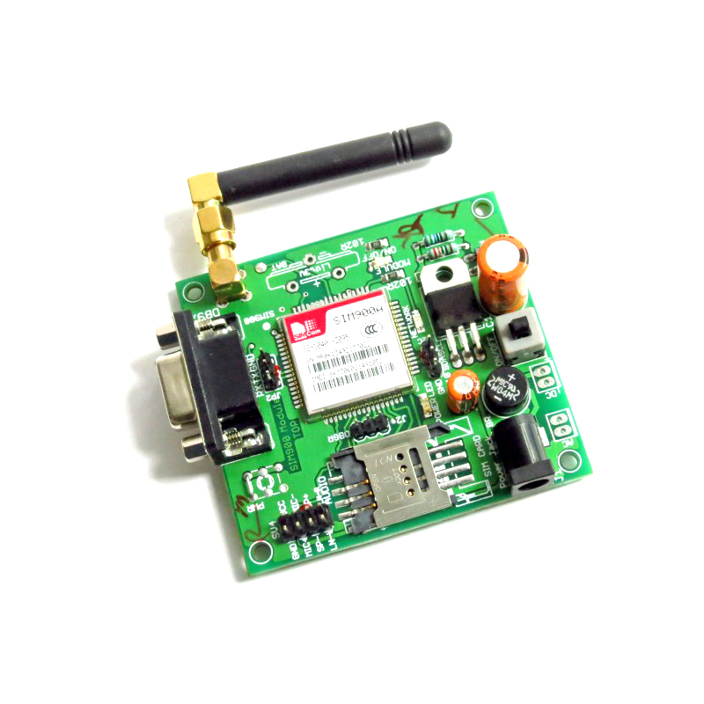
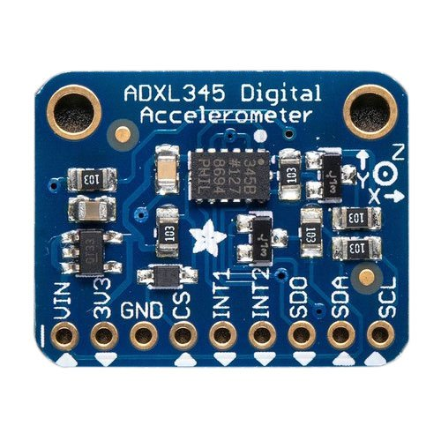
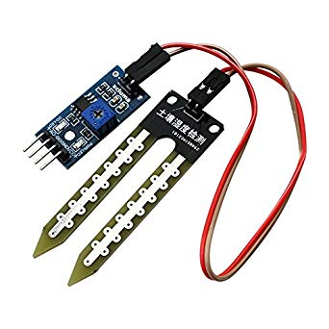

Accelerometer
GSM Module
Ultrasonic Sensor
Moisture Sensor
Arduino

Slide 6

Accelerometer
Accelerometer
Moisture Sensor

Slide 7
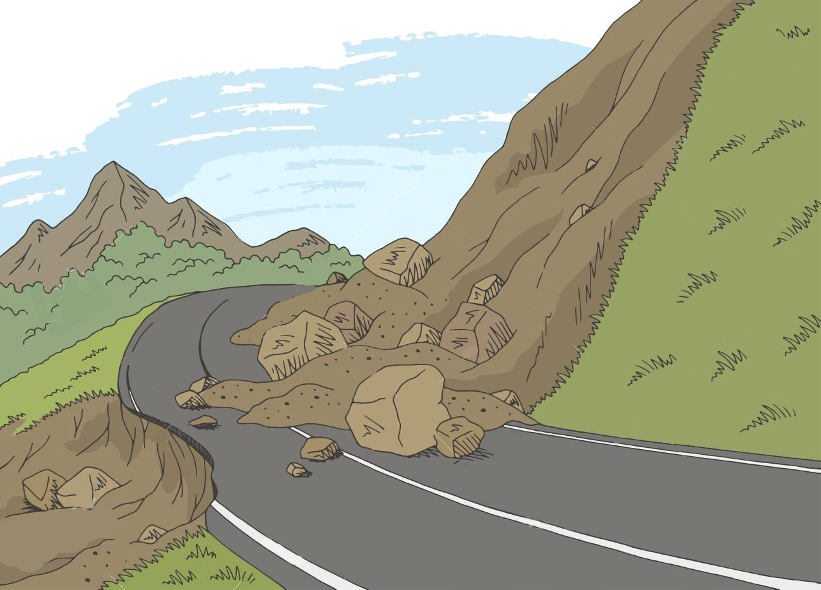
Ultrasonic Sensor

Slide 8

Emergency:-
Wakna003
Landslide ahead.
GSM Module

Slide 9
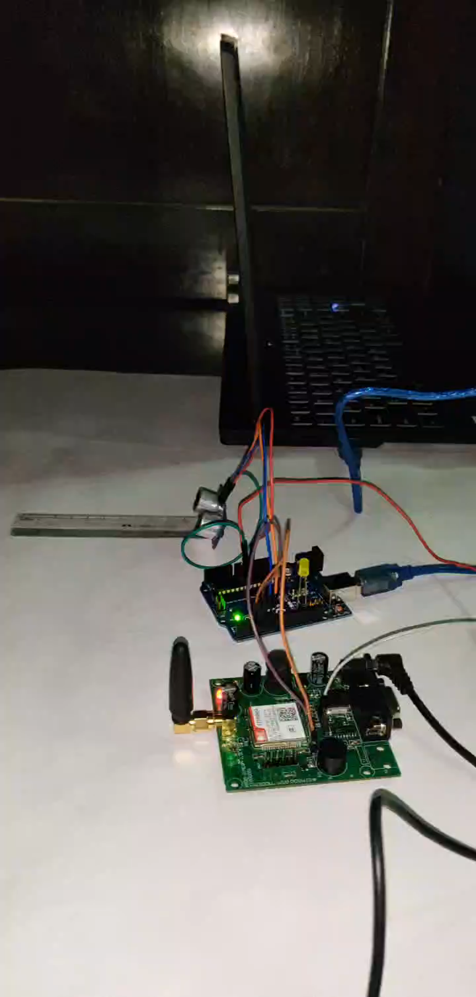

Slide 10
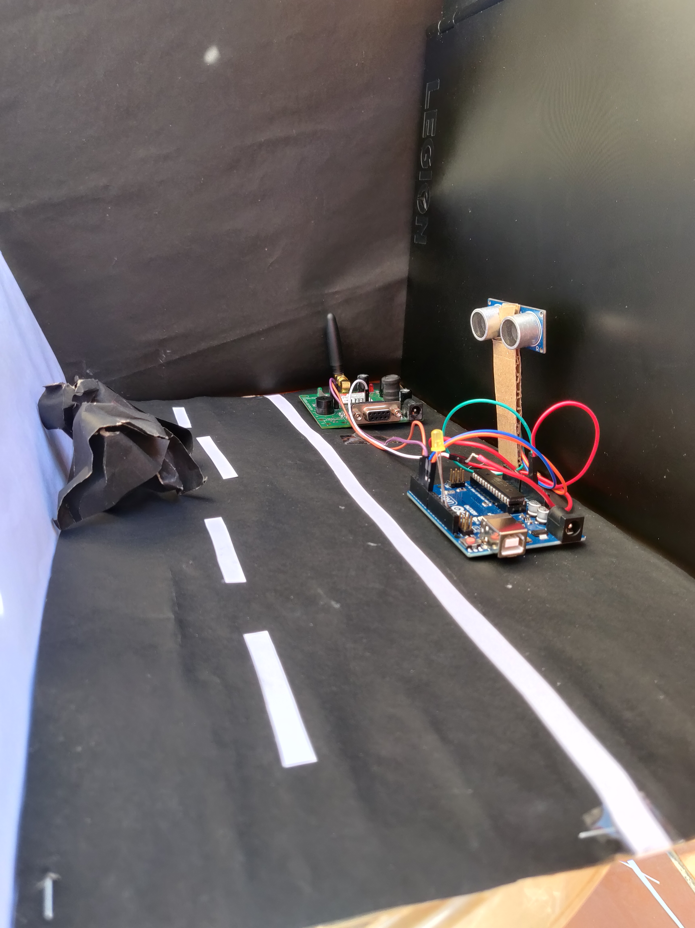
Prototype Model
A complex idea can be conveyed with just a single still image.

Slide 11
THANK YOU

